Slide 1
Algorithmic Trading
as a
Markov Decision Problem
Anton Rubisov
Space Robotics Lab
2014 10 23

Slide 2
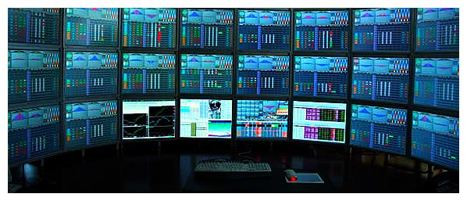
A few definitions to begin...
Algorithmic / High-Frequency Trading:
    rapid (< 1s) transactions
    algorithmic execution
    maintain no inventory at day's end

Slide 3
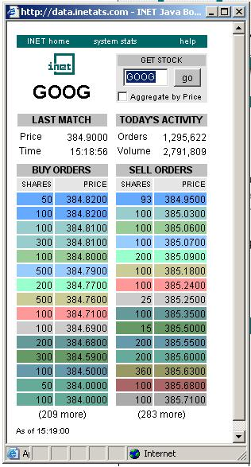
A few definitions to begin...
Limit Order Book (LOB):
    a system (in the dynamics sense)
    tracks arrival of buy and sell orders of a given asset
    executes trades when a match is made

Slide 4
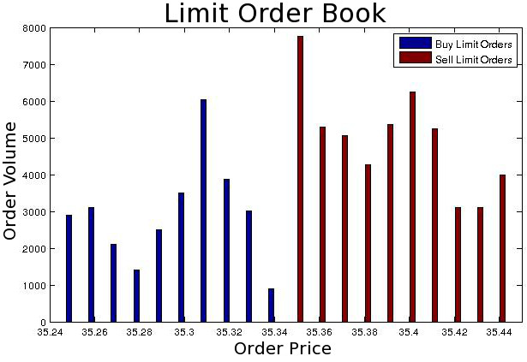
A few definitions to begin...
LOB transformed into:

Slide 5
Research Goal
Our goal is to use the dynamics of the Limit Order Book (LOB) as an indicator for high-frequency stock price movement, thus enabling statistical arbitrage. Formally, we will the study limit order book imbalance process, , and the stock price process, , and attempt to establish a stochastic relationship . We will then attempt to derive an optimal trading strategy based on the observed relationship.

Slide 6
Research Programme
Modeling LOB dynamics
Relating order imbalance and price change
Exploratory data analysis
Deriving an optimal trading strategy

Slide 7
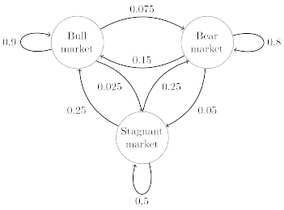
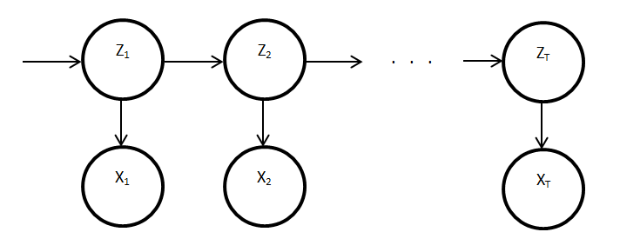
Modeling LOB Dynamics
To achieve goal, we need a suitable model
Markov condition considered appropriate
Hence, options:
  Markov Chain, Continuous-Time Markov Chain, Hidden Markov Model, …

Slide 8
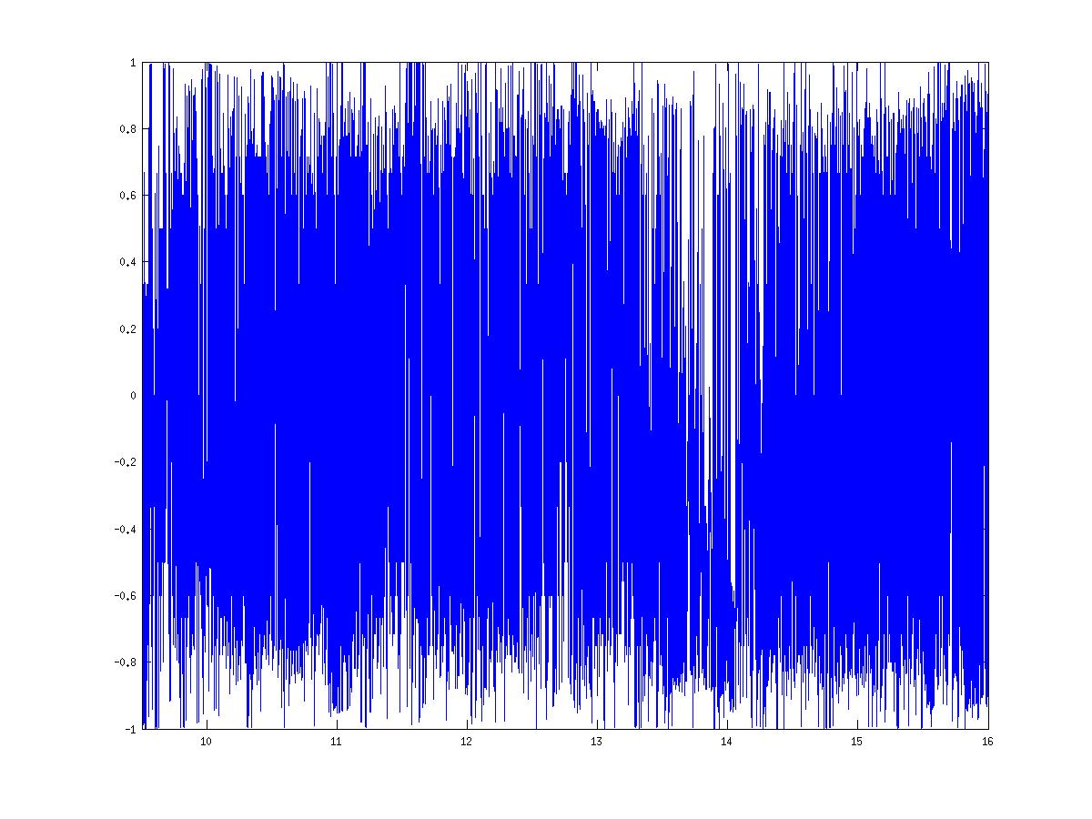
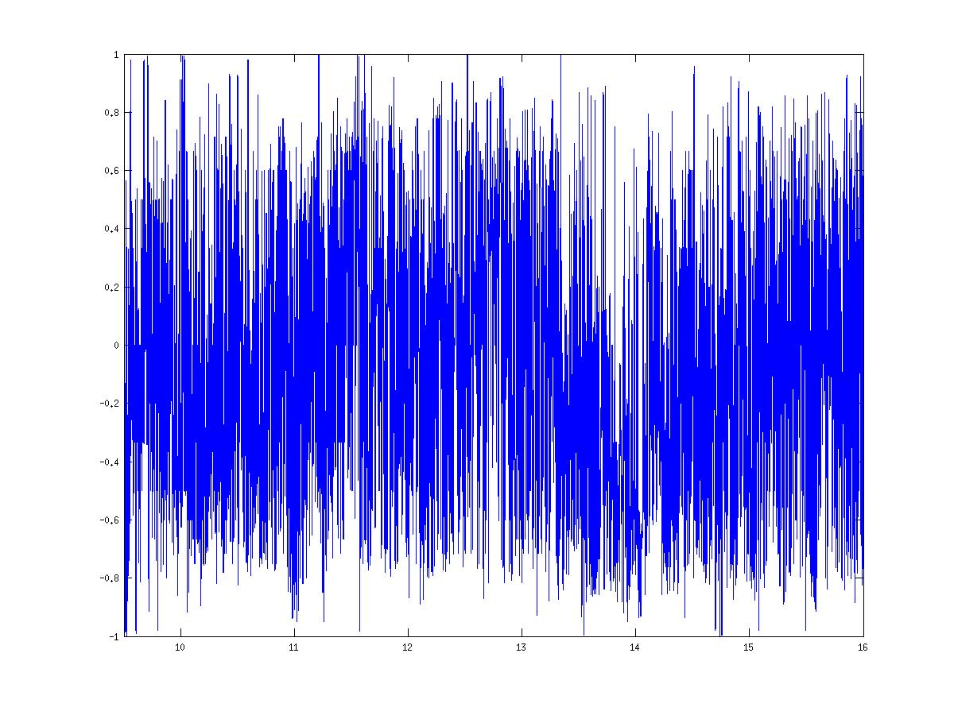
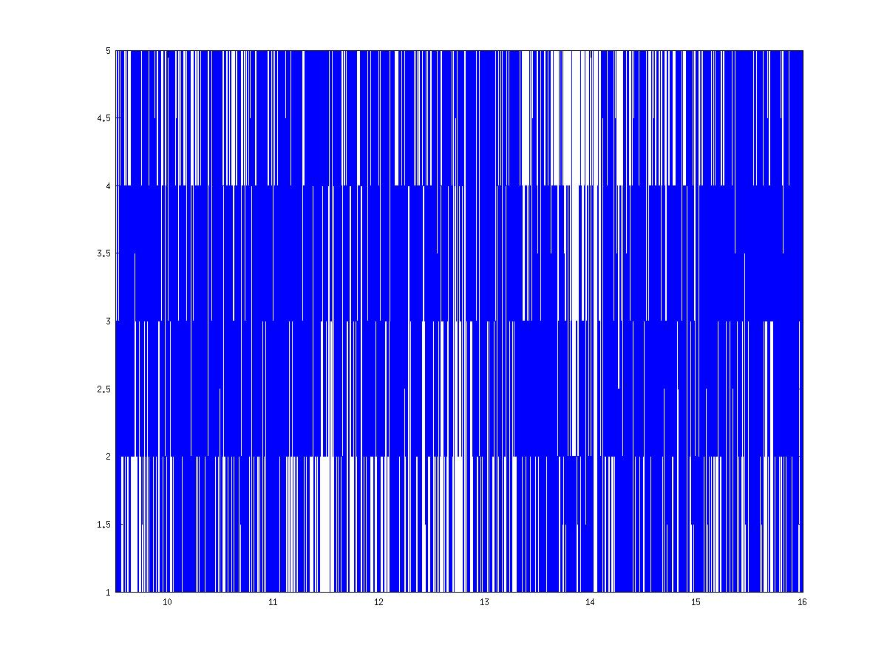
Modeling LOB Dynamics
The imbalance process is very noisy...
  So we average using a fixed interval...
  And put it into bins

Slide 9
Modeling LOB Dynamics
Given the interval averaging and binning, we could use discrete-time
But, continuous-time is more powerful
Continuous-Time Markov Chain:
  Contains an embedded discrete-time Markov chain
  Therefore an obvious and simple choice

Slide 10
Research Programme
Modeling LOB dynamics
Relating order imbalance and price change
Exploratory data analysis
Deriving an optimal trading strategy

Slide 11
Imbalance and Price Change
Consider joint distribution for
Reduced to 1-dimension and estimated CTMC generator matrix , satisfying:
Elements of P are:
Rewritten:

Slide 12
Imbalance and Price Change
(shorthand)
Using Bayes' Rule, can solve:
Probability of current price change conditional on current imbalance, previous imbalance, and previous price change

Slide 13
Imbalance and Price Change
Using 3 bins, 1000ms imbalance smoothing, and 500ms price change, we computed:

Slide 14
Imbalance and Price Change
Using 3 bins, 1000ms imbalance smoothing, and 500ms price change, we computed:
Interpretation: there is price change momentum when staying in same imbalance bin

Slide 15
Research Programme
Modeling LOB dynamics
Relating order imbalance and price change
Exploratory data analysis
Deriving an optimal trading strategy

Slide 16
Exploratory Data Analysis
Using the observed price change momentum, we explore a few trading strategies:
  Naive: execute a buy (resp. sell) market order if the probability of an upward (resp. downward) price change is > 0.5
  Naive+: extend the Naive strategy to additionally keep limit orders posted at-the-touch if the probability of a price change is < 0.5
  Naive++: Like the Naive strategy, but using LOs instead of MOs

Slide 17
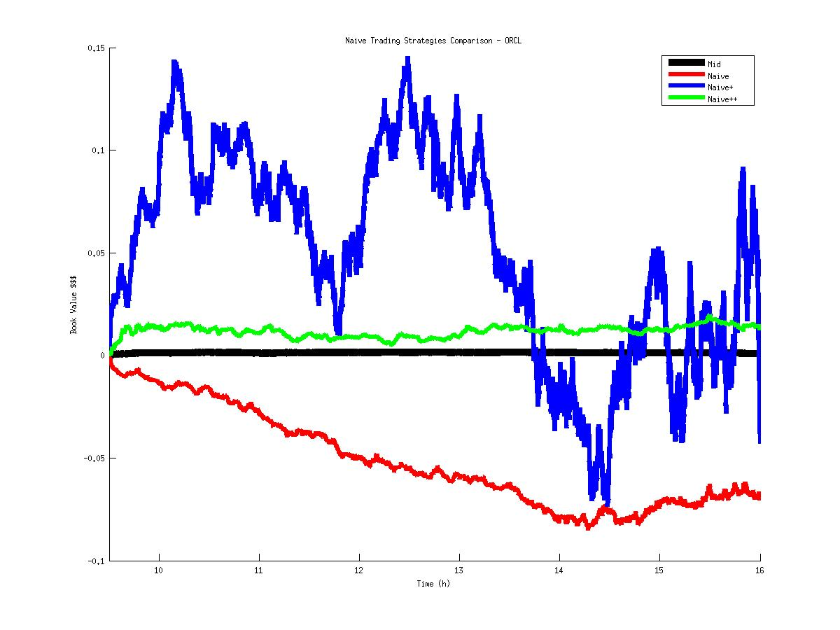
Exploratory Data Analysis
ORCL

Slide 18
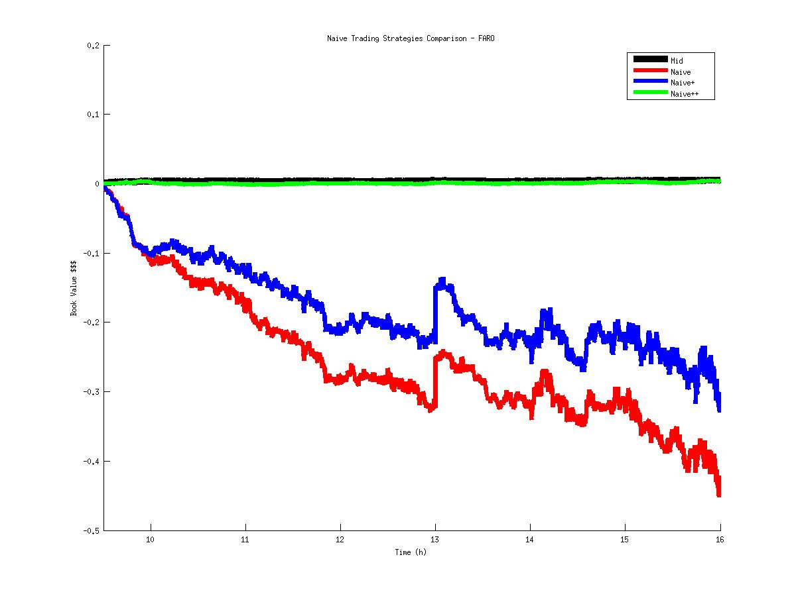
Exploratory Data Analysis
FARO

Slide 19
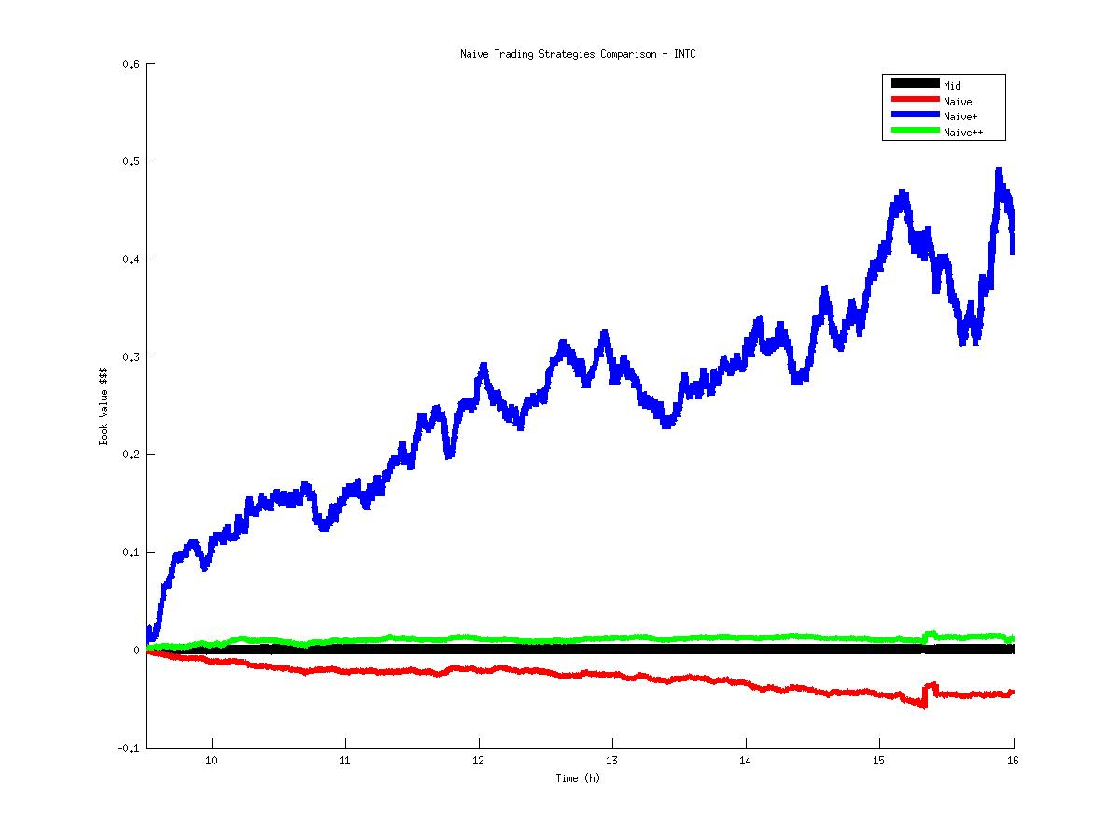
Exploratory Data Analysis
INTC

Slide 20
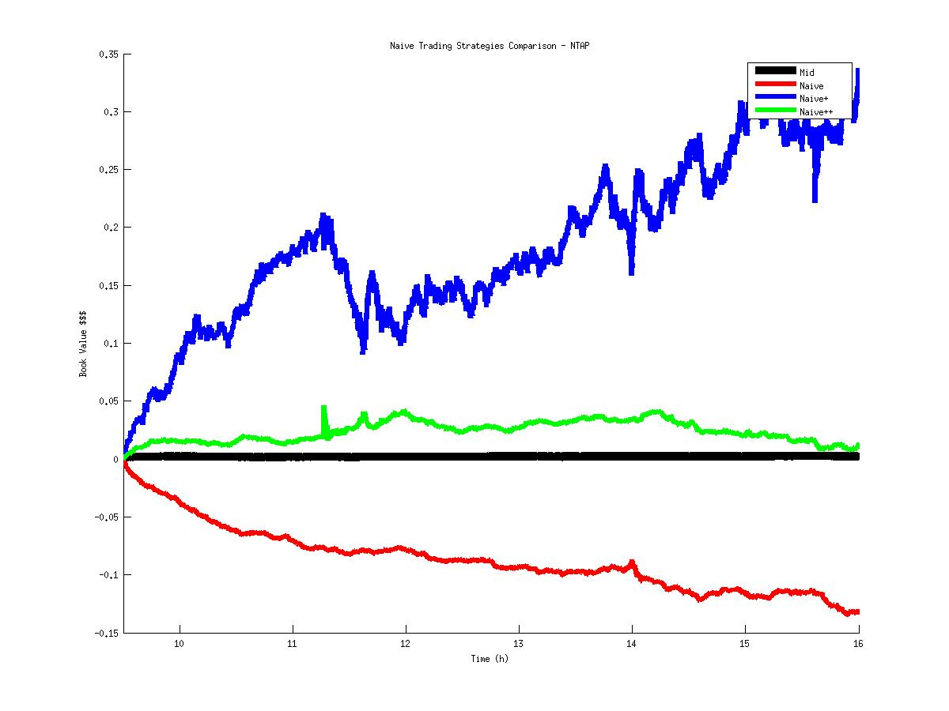
Exploratory Data Analysis
NTAP

Slide 21
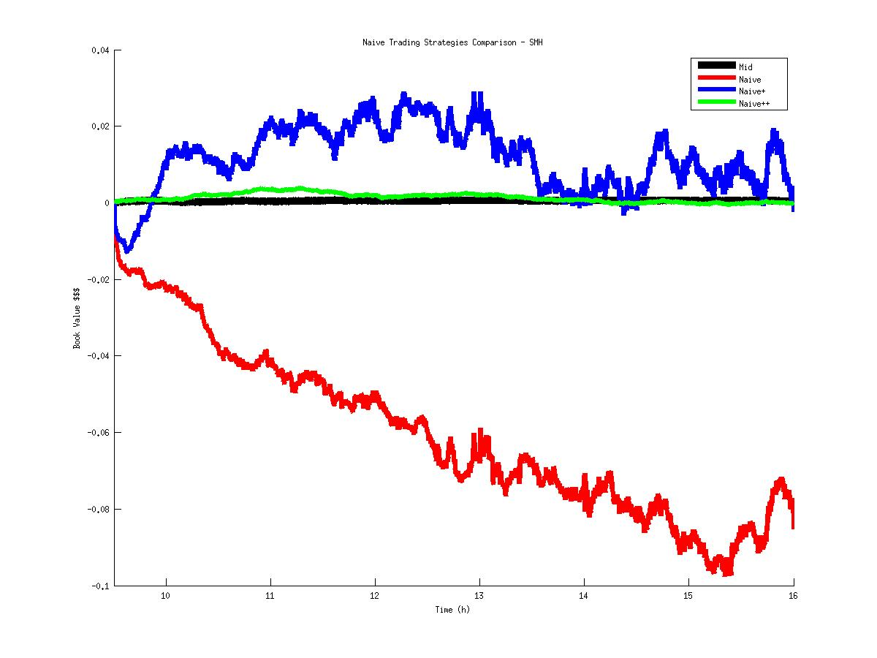
Exploratory Data Analysis
SMH

Slide 22
Exploratory Data Analysis
Conclusion: posting at-the-touch LOs on average produces positive returns
Other considerations still being investigated:
  How do we calibrate parameters?
  How do we compute imbalance?

Slide 23
Research Programme
Modeling LOB dynamics
Relating order imbalance and price change
Exploratory data analysis
Deriving an optimal trading strategy

Slide 24
Optimal Trading Strategy
- market orders strategy
- cash at time t given orders m
- stock price at time t
- bid/ask spread at time t
- buy MO at time t
- sell MO at time t
- # shares held at time t
Cash stream:

Slide 25
Optimal Trading Strategy
- market orders strategy
- cash at time t given orders m
- stock price at time t
- bid/ask spread at time t
- buy MO at time t
- sell MO at time t
- # shares held at time t
Cash stream:

Slide 26
Optimal Trading Strategy
Terminal (end of day) wealth:
How do we measure performance or constrain possible strategies m?

Slide 27
Optimal Trading Strategy
Maximize profit
Minimize loss
Risk aversion
Maximize Sharpe ratio
Maximize Sortino ratio

Slide 28

Next Steps
Include limit orders into stochastic framework
Derive optimal trading strategy based on Markov Decision Processes
  dynamic programming
Lots of:

